Slide 1
PIONEERING DIGITAL
Article By David Martin
(CEO FANTASY)

Slide 2

Introduction
The article talks about a UI & UX based company named Fantasy, which was now 20 years old and and gives a walkthrough of their early years in digital and some of their pioneering UX achievements. UI development gained a boost with the introduction of Flash.
Flash
An HTML replacement had arrived from Macromedia called; Flash in 1999
Flash was the Apple OS of the 2000s. It came with a blank canvas format, an arsenal of new creative tools unseen previously, and a lawless design etiquette.
Flash, enabled to create solutions for UX problems that were not previously possible with HTML. The (Flash) community was small but the pioneering in there was enormous and set the train in motion for you as designers today.
Disadvantages Flash websites came with a heavy file size penalty. They also came with poor animation playback if larger animations were not precached.

Slide 3
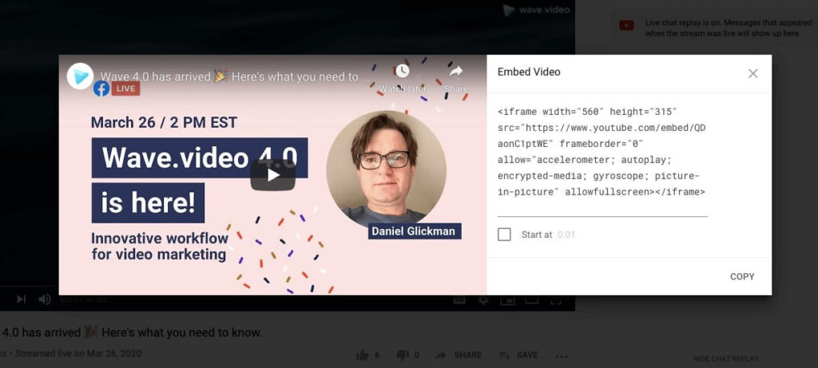
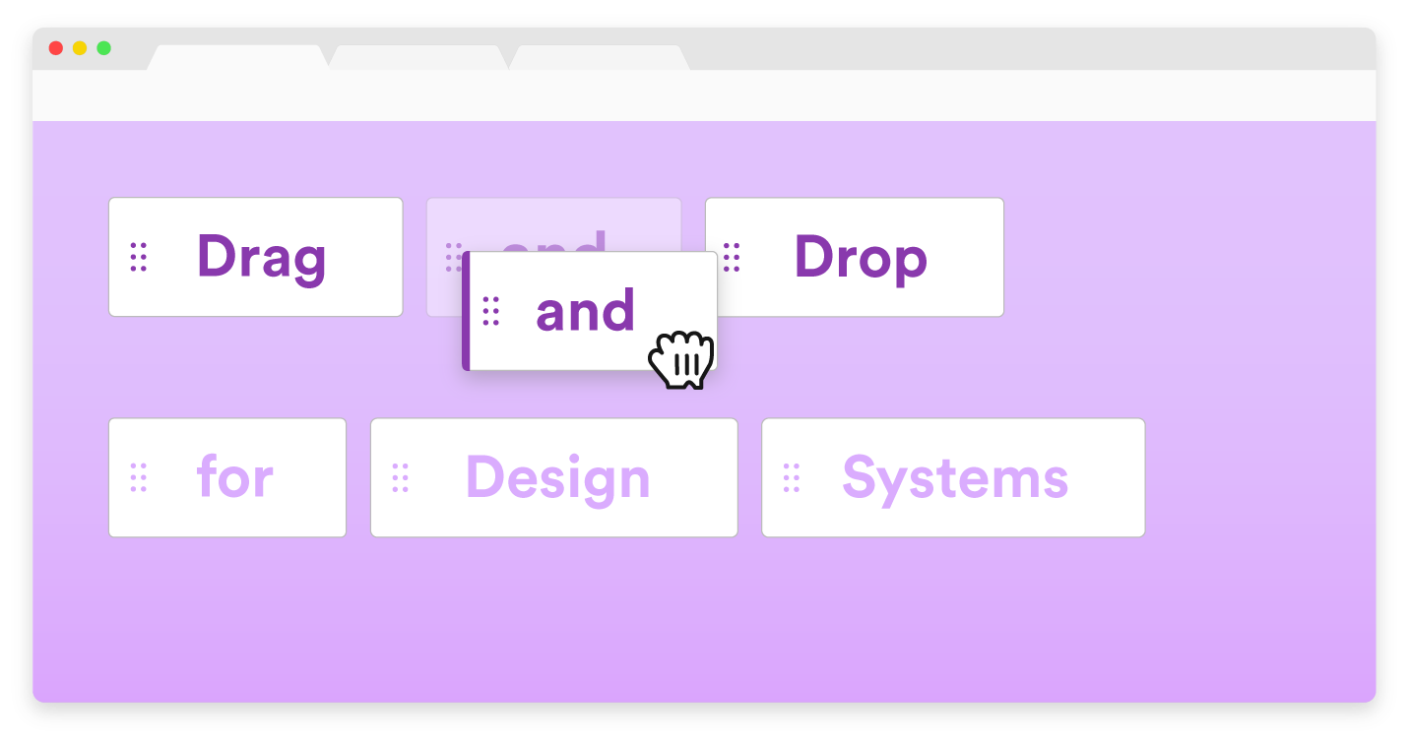
Some Notable Contributions of Fantansy
1. First video Embedded website
2. Draggable Objects

Slide 4
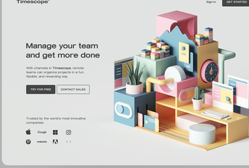
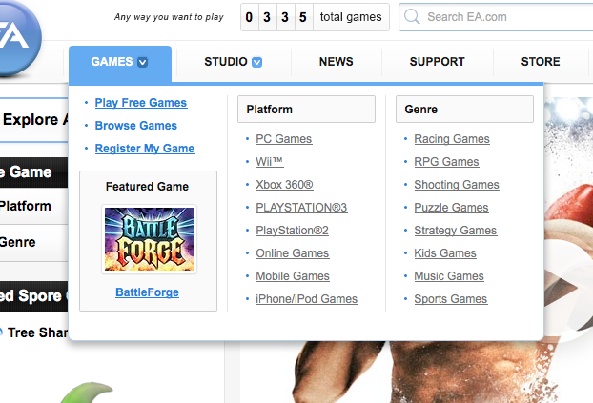
3. 3D Web Design
4. SuperMenus

Slide 5
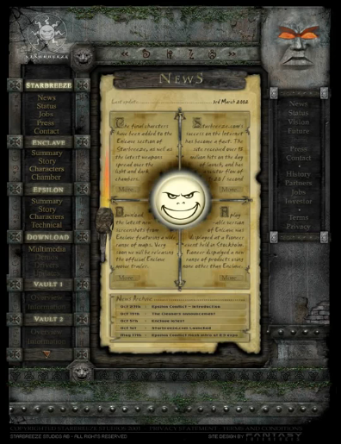
Pioneering moments
First Onboarding: This was the first onboarding of it’s kind for an online experience in 2000 for Starbreeze.
Main Menu divided into Sections:
Starbreeze - tells all about Starbreeze Studios
Enclave - exclusive insights about Enclave
Epsilon - previews and information about game called Epsilon Conflict
Download - to download funny and useful demos and drivers
Vault 1 & Vault 2 - setoff for future games
There are also a few Browser type buttons to navigate on the site.
Tour of Website

Slide 6

First Smart Loading System:
Flash websites came with a heavy file size penalty.
They also came with poor animation playback if larger animations were not pre-cached.
Fantasy created smart loading systems to dramatically speed up the experience.
They included loading the shell only of the website which would typically have an instant load, followed by a priority preloading system that would load components in as we predicted which sections the user would travel to next.
We also played animations off stage when the system was idle, which the user could not see.
This resulted in a smooth playback of more frame heavy animations. This method was later adopted by the industry as a whole.

Slide 7
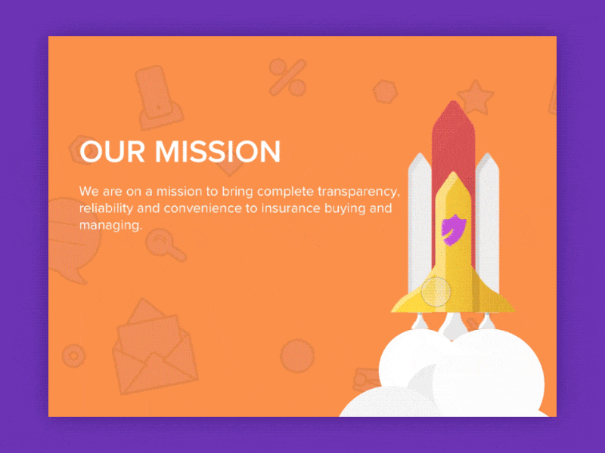
First 60 - 90 FPS
Motion was one of the core part of Fantasy’s Offering, but it was difficult to reach the quality that television provided
Fantasy started using higher frame rates to make the motions more fluid.
The trend caught on after Warner Bro’s used higher frame rates to achieve interactive fluidity with their UI

Slide 8
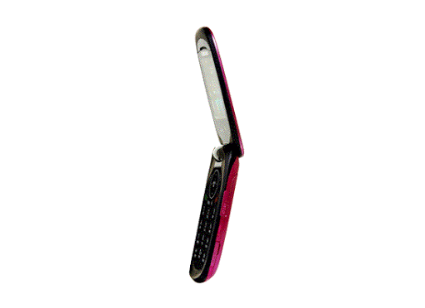
First Drag and Rotate
In 2000, Fantasy built a website for a Swedish video post-production company, Fido Fim.
They had some amazing assets, including 3d renders from the popular commercials produced for clients.
This was another industry first and Microsoft took note, hired them to bring that experience to their Xbox online websites.

Slide 9
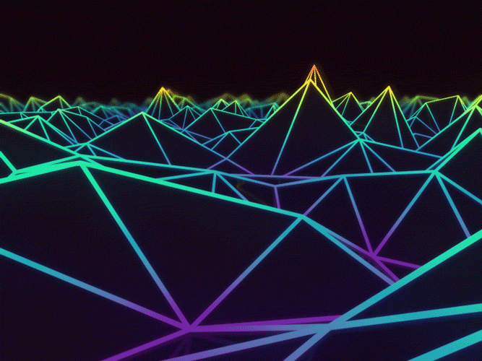
First 3D
Among others, Fantasy brought 3D to the interactive web but possibly in a bigger way than most. We had employed game designers using specific 3D software (Maya) to develop 3D assets we could specifically animate for flash.
New techniques were used as flash did not support 3D Animations. New masking techniques, rendering techniques, attention to details were of the most importance.

Slide 10
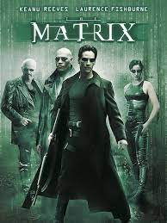
First with video playback on the web
In 1999, Fantasy designed a spoof trailer for the 2nd Matrix movie
before it was announced.
Using Flash, a sequence of exported images and a soundtrack called
“Angel Falls” we spoofed the internet into thinking this was a
glimpse of the real thing.
It as featured on the official “Keanu Reeves fan page”.
Although Flash was incapable of playing video seamlessly on the
web with Flash 4, they played the component of stage, meaning the user could not see it but the memory loaded it into the cache and when the user pressed play, it felt as smooth as 30FPS.

Slide 11
In the year 2001, for an ISP super portal owned by Time Warner, they built an entire ecosystem of settings, news, and entertainment content for its users to steer them away from Yahoo and AOL.
Each time their millions of customers would open a browser it defaults to the new flash RR.com super portal.
That very platform saw some unique UX firsts including being the first-ever portal in flash.

Slide 12
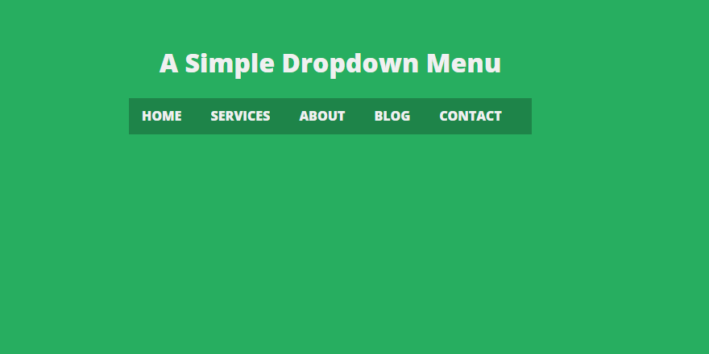
First Super Menu
Perhaps this was one of the favorite pioneering designs of David Martin- the Founder & President of FANTASY.
The super menu was simply a secondary sub-menu appearing on rollover of an item in the main menu.
Not all text-based but it included images. Many followed using super menus throughout their ecosystems.

Slide 13
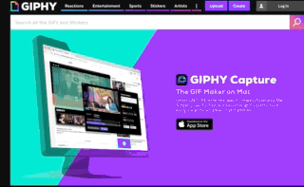
First Seamless Embedding
Partnering with CNN they implemented their videos into the Time Warner-owned portal, seamlessly.
This meant there was no overlapping pop up player and the videos played within the POD structure of the portal.
This also marked the first time CNN videos were consumable online even before they were available on CNN.com itself (which we later designed).
Later in 2007, they brought MTV’s portfolio of videos online for the first time also with a flash portal.

Slide 14
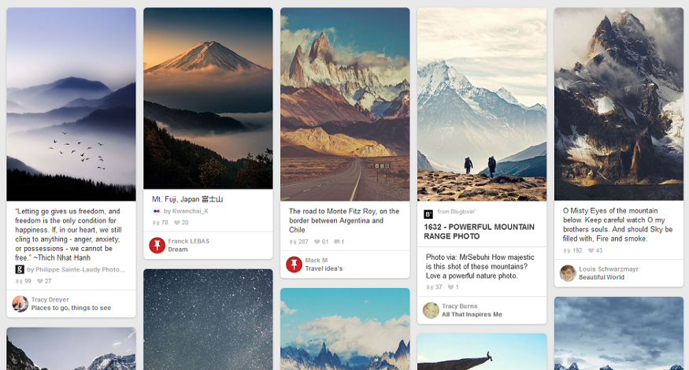
First Pods / Card Design
The pod design, today knows as “cards”, first appeared on a 2001 version of our own website.
The Pod/card was a grounding mechanism to hold info within that pod while giving a grid-like structure to the rest of the site.
Cards can be of any shape, color and form. But in general, they all contain pictures, icons and some basic text information, such as title, user name and location information.

Slide 15
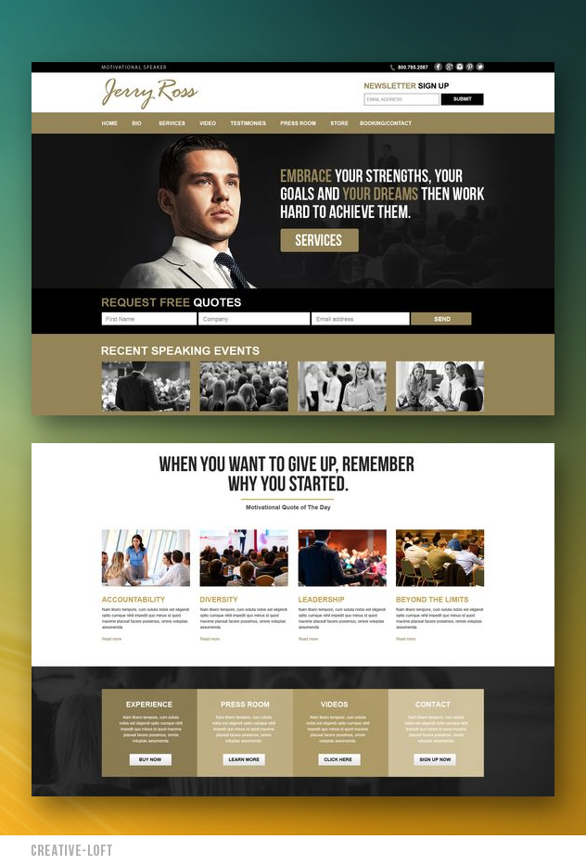
First Section Colors
Before websites had colors to help define their news from their entertainment, Road Runner was the first to market with a color mode depicting sections of the portal. Many followed.

Slide 16
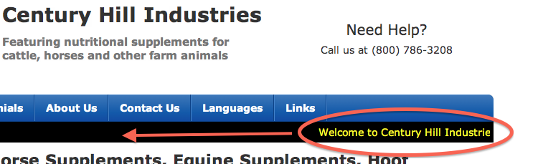
First Marquees
At the top of the core pages, we needed a “pod” that was the main attraction.
We called them “EP’s” (executive pods), today they are called marquees.
An HTML marquee is a scrolling piece of text displayed either horizontally across or vertically down your webpage depending on the settings.

Slide 17
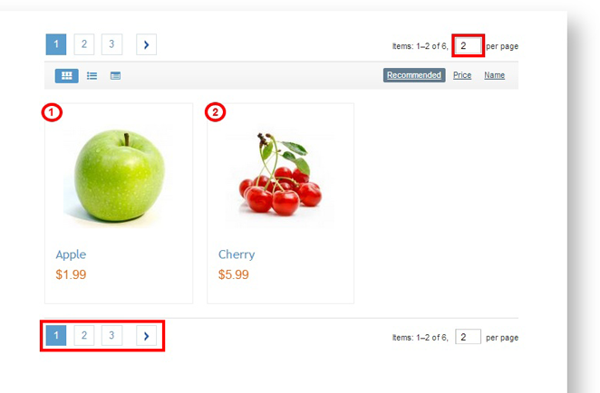
First Pagination
Pagination is a method of dividing web content into discrete pages, thus presenting content in a limited and digestible manner.
We added pagination, both an industry first. The new format was soon picked up by CNET and Apple.

Slide 18
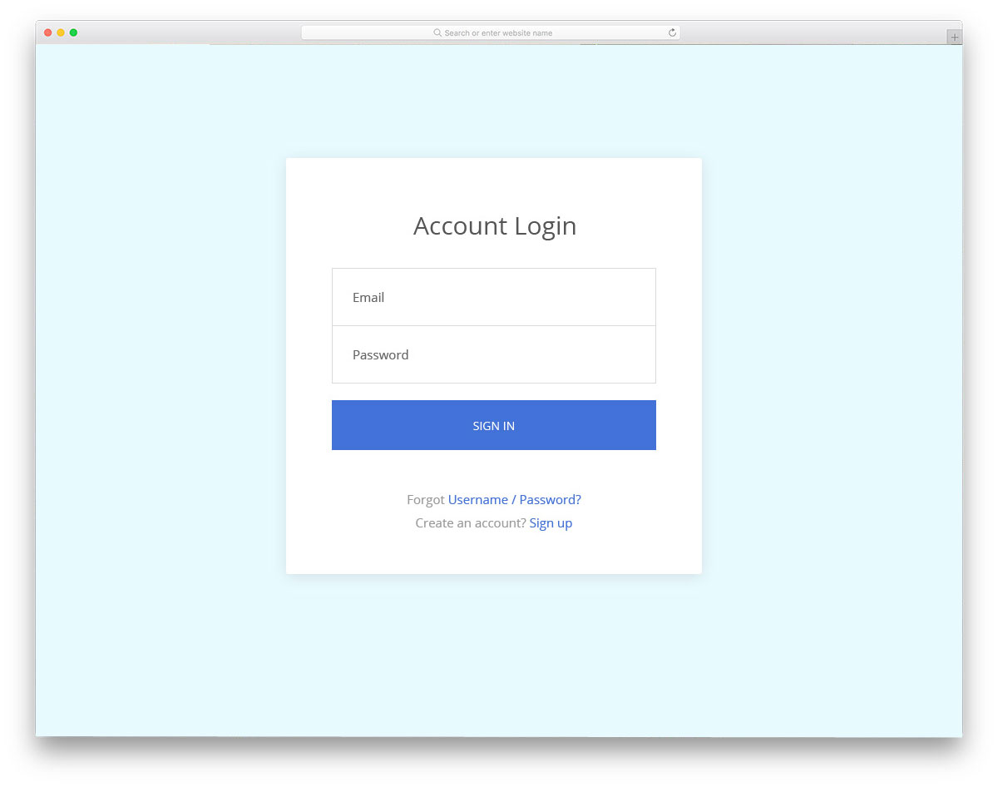
First to do Single Sign-On
As Time Warner and Road Runner merged, we created a single sign-on mechanism for the portal.
That engineering was done primarily by Road Runner employees.
It was the first login integration of its kind.

Slide 19

First Google Ads Integration
The first-ever Google ads implementation on a 3rd party website was on the Road Runner platform (which we later brought to AOL.com).
At the top of the portals UI, we designed a large search bar “powered by Google”.
We designed a new format with a light yellow and pink background which was then adopted by Google themselves and used until recently.
Google earns loads of revenue by their ads till date.

Slide 20

Ford
In 2005 we convinced Ford Vehicles to fully invest in a richer user experience for Ford.com. The case study itself was an industry first where the agencies and client produced a video case study of the .com.

Slide 21
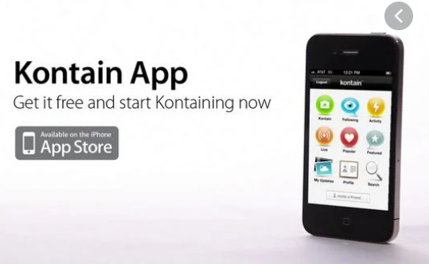
Kontain App
In 2007 fantasy designed and built a social media platform focused on sharing your photos and videos. They had quite some traction with the design community.
Their focus was on desktop when it should have been on mobile. Instagram launched their mobile platform with filters and that was that.
Their app came too late to the party.

Slide 22
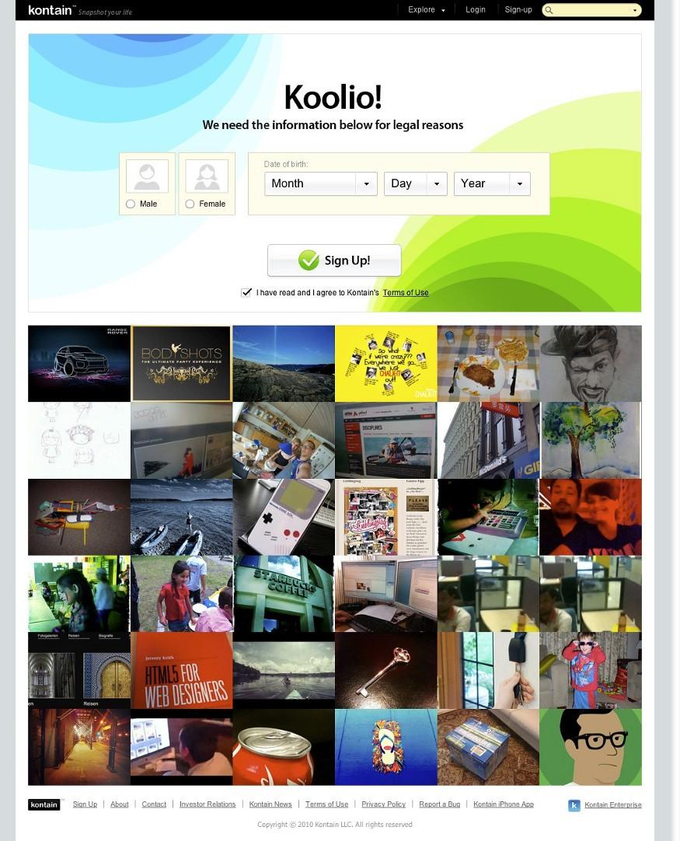
First Super Sign up forms:
The Sign Up for anything form had to be one of the most boring and traditional looking UX components used on the internet.
The aim was to create the easiest possible signup experience which broke conventions.
They were competing with Facebook and Tumblr, by creating Kontain.

Slide 23
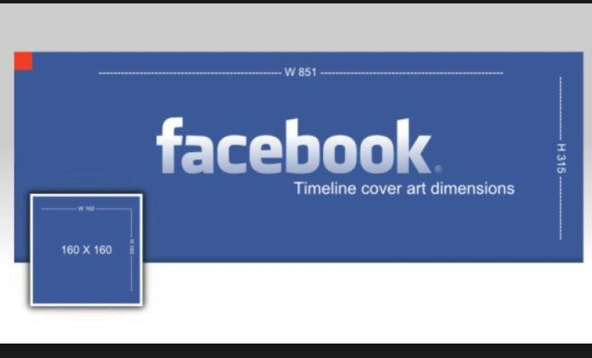
First Cover Photo:
The profile section of Kontain had a cover feature where users could upload an image along with their profile image.
A few months later facebook deployed the exact same feature followed by Twitter etc.

Slide 24
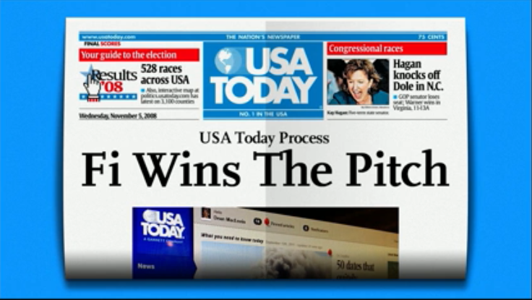
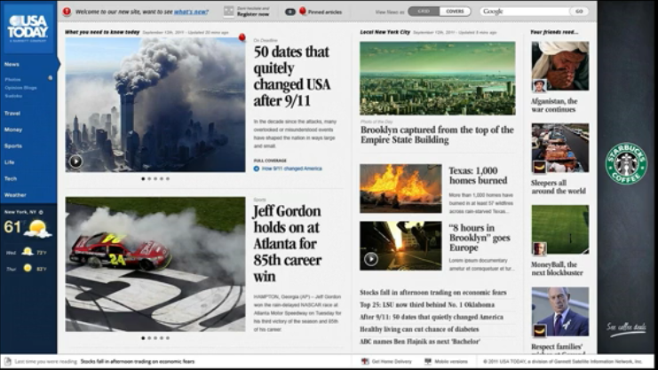
New ad format:
- For USA Today and others they broke the standard IAB ad rules.
-They developed a prototype for Gannett / USA Today to sell a richer media ad format to their clients before the site was developed.
- It was a massive success and later adopted by all of Gannett’s properties.

Slide 25

HTML 5
HTML5 arrived as we drove those experiences for Toyota, Google, and Microsoft to exhibit the capabilities of a new generation of Chrome and IE browsers.
New platforms arrive on a far more regular basis to design for.
Fiber is actually here.
Clients will invest in great user experience.
There is far more inspiration.
Users are very susceptible to poor design experiences.
Motion is not just cool it’s actually useable to improve an experience.

Slide 26
How to Pioneer Today ?
New platforms arrive on a far more regular basis to design for.
Fiber is actually here.
Clients will invest in great user experience.
There is far more inspiration.
Users are very susceptible to poor design experiences.
Motion is not just cool it’s actually useable to improve an experience.

Slide 27
“Pioneering is not just being first, it’s pushing the bar. A bar that’s not as high as it looks from the bottom. When you get closer to the top of your trade, it’s only then you truly realize how far we can go and how easy it was to get here.”

Slide 28


